Slide 1

Introduction to Big Data and AWS
Session 1
Sandra Pico Oristrell
December 2023

Slide 2
Agenda
Part 1: Theory (1:30h)
Course structure and evaluation
Introduction to Big Data on Amazon Web Services (AWS)
Foundations of Amazon Web Services (AWS)
Break (15 min)
Part 2: Hands-on (1:15h)
AWS Educate
Hands-on Labs
Lab 1: Getting Started with Cloud Operations (30 min)
Lab 2: Getting Started with AWS Security (40 min)

Slide 3
Part 1: Theory

Slide 4
Course structure and evaluation

Slide 5

Introduction
Lead Senior MLOps Engineer @HP, Barcelona (Spain)
ML Engineer & Data Scientist Consultant @AWS, Stockholm (Sweden)
HC Tech Specialist @PwC, Stockholm (Sweden)
Research Engineer @KTH , Stockholm (Sweden)
Bachelor’s Degree, Electronic Systems Engineering in Communications @LaSalle
Master’s Programme, Machine Learning @KTH
Sandra Pico Oristrell

Slide 6
Objectives
Course description
La asignatura de Big Data en la Industria pretende acercar al alumno a las múltiples aplicaciones y casos de uso que tiene el Big Data en el mundo real. Se expone al alumno a distintas situaciones y contextos para que vea qué alternativas hay en el mercado para solucionar un problema determinado y cómo el enfoque con tecnologías Big Data puede ayudar a mejorar las prestaciones de los sistemas actuales.
El objetivo principal de esta asignatura es que el alumno sea capaz de trasladar todos los conceptos y teoría que se ven a lo largo del máster a casos de uso y aplicaciones reales. En esta asignatura el alumno será capaz de entender los requerimientos de un problema Big Data, analizar posibles soluciones y proponer la mejor alternativa tecnológica.

Slide 7
Structure
Session 1 (30.11.23): Introduction to Big Data and AWS
Session 2 (11.12.23): Databases
Session 3 (12.12.23): Data Lakes
Session 4 (14.12.23): Data Pipelines
Session 5 (18.12.23): Machine Learning Operations (MLOps)
Session 6 (20.12.23): Data Analytics and visualization

Slide 8
Session’s structure
Each session will last 3 hours.
Each session will be structured as follows:
Half of the session will focus on the theory and real-life use cases (Session 2-6) from the selected topic.
Each session will have 15 minutes break.
The last half of the session will have some practical hands-on on the selected topic or related.

Slide 9
Cloud Computing Platform: AWS
To explain the main content of the course, we will leverage Amazon Web Services (AWS).
Amazon Web Services (AWS) is the world’s most comprehensive and broadly adopted cloud, offering over 200 fully featured services from data centers globally. Millions of customers—including the fastest-growing startups, largest enterprises, and leading government agencies—are using AWS to lower costs, become more agile, and innovate faster.
What is AWS (amazon.com)

Slide 10
Course evaluation
The final grade of the course will be 100% based on the submitted project.
The project can be done in pairs or individually.
The project may focus on the different topics presented during the course and will be freely chosen.
The project should focus on a real use case in the industry. Two already defined use cases will be suggested, but you will have the possibility to choose a use case freely.
Coding will be optional, as the project will focus on building an architecture diagram for the chosen use case.
The project will be explained with further details in the last session of the course.

Slide 11
Introduction to Big Data on AWS

Slide 12
Big Data
Google Cloud defines Big Data as follows:
Big data refers to extremely large and diverse collections of structured, unstructured, and semi-structured data that continues to grow exponentially over time. These datasets are so huge and complex in volume, velocity, and variety, that traditional data management systems cannot store, process, and analyze them.
AWS identifies the challenges of Big Data through five key challenges:
Volume
Velocity
Variety
Veracity
Value
Not all organizations experience challenges in every area. Some organizations struggle with ingesting large volumes of data rapidly. Others struggle with processing massive volumes of data to produce new predictive insights. Still others have used that need to perform detailed data analysis on the fly over enormous data sets.

Slide 13
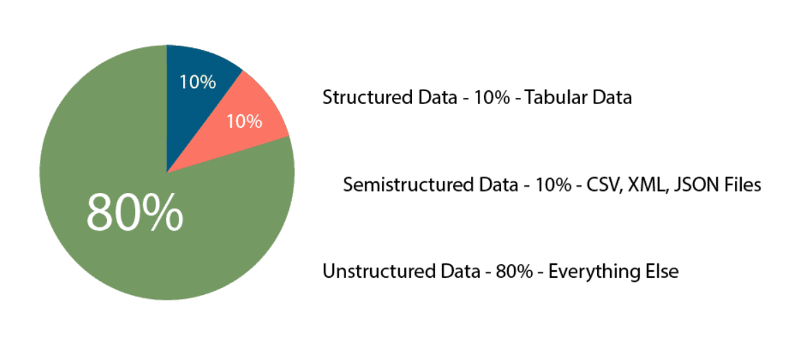
Big Data
Volume and Variety
Data is getting bigger and more diverse every single day.
Transactions
Web Logs and Cookies
Connected Devices
Social Media
AWS Data Analytics Fundamentals
Structured vs Unstructured Data: Key Differences | Datamation

Slide 14
Big Data
Velocity
The speed at which data is being generated is ever accelerating. Emails, photos, Twitter and Facebook posts, log files, and IoT devices are all examples of data that is being generated rapidly and must be collected, processed, analyzed, and stored at high speeds. The collection and processing of data are combined into a single concept known as data processing.
Data Collection
Data Processing
Batch Data Pipelines
Gathering data from multiple data sources into a single storage place.
Formatting, Organizing and Controlling data.
Streaming Data Pipelines

Slide 15
Big Data
Veracity
Data changes over time. As it is transferred from one process to another, and through one system and another, there are opportunities for the integrity of the data to be negatively impacted. You must ensure that you maintain a high level of certainty that the data you are analyzing is trustworthy.
Creation
Aggregation
Storage
Access
Share
Ensuring data accuracy.
Ensure data aggregation method is correct.
Auditing to ensure the integrity of the data (e.g., not updated)
Users get access to the data. Should be read-only.
Usually when the veracity errors appear, as business users are the ones aware on the data.

Slide 16
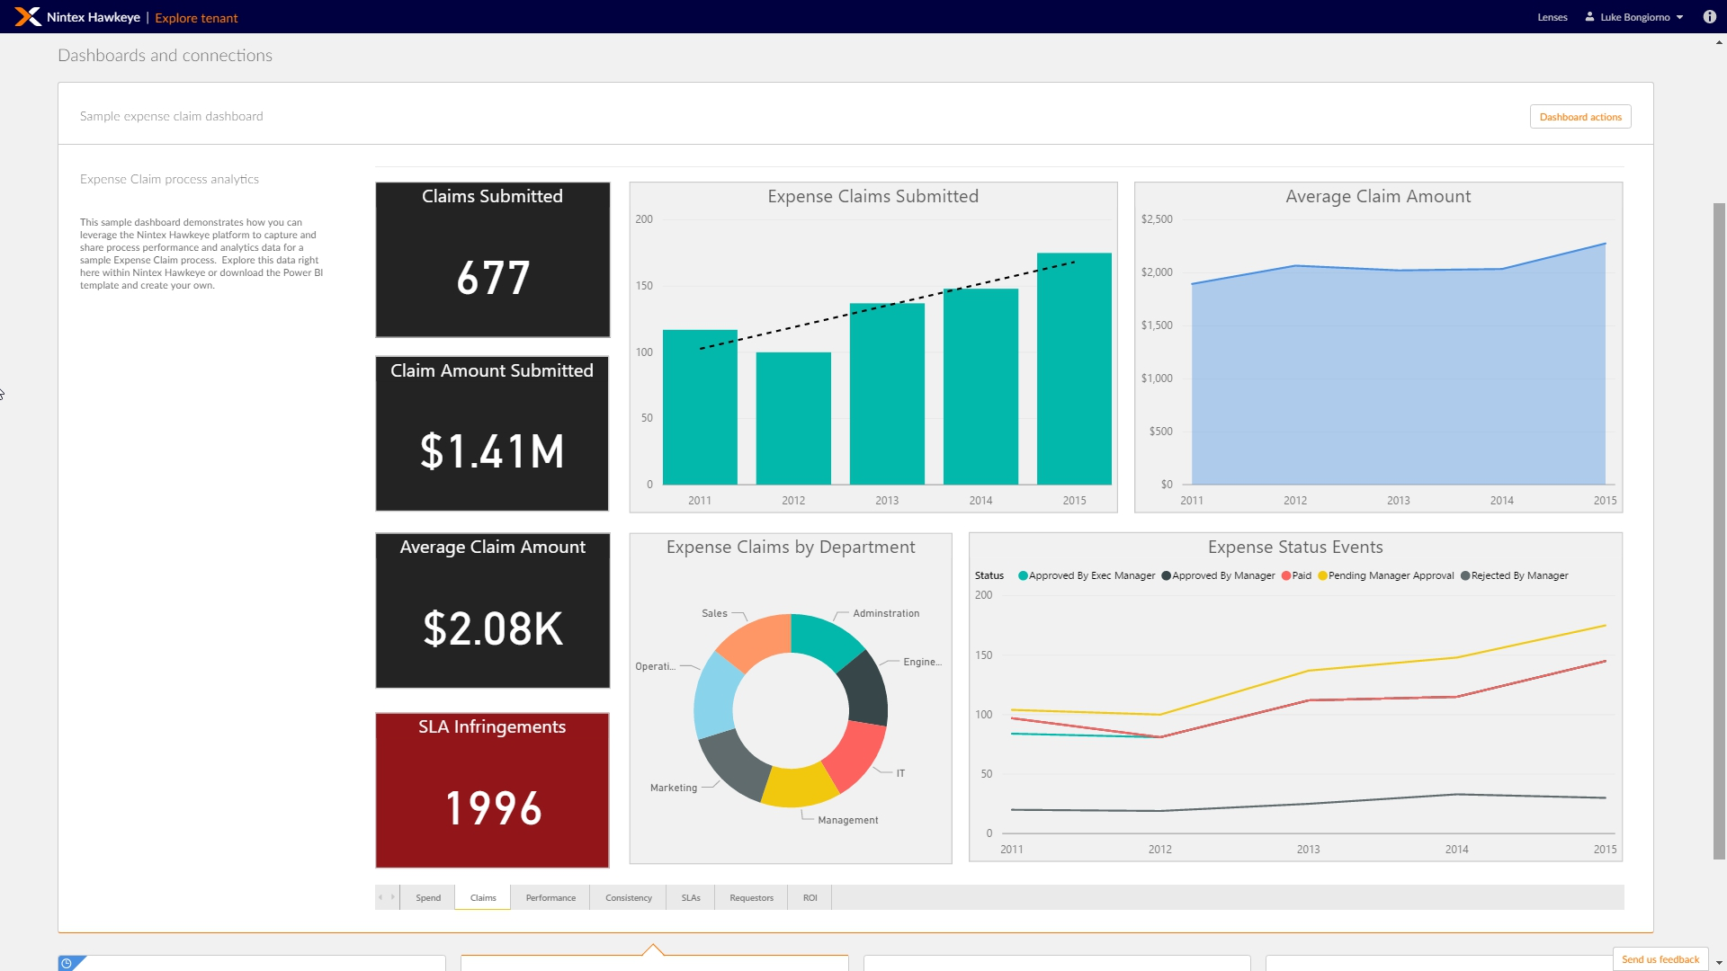
Big Data
Value
Dashboards and Reports

Slide 17
Big Data on AWS
Data Sources
Data Storage
Batch Processing
Analytics Storage
Reporting
Machine Learning
Real-time Ingestion
Streaming processing

Slide 18












Big Data on AWS
Data Sources
Data Storage
Batch Processing
Analytics Storage
Reporting
Amazon DynamoDB
AWS Glue
Amazon EMR
Amazon QuickSight
Amazon Simple Storage Service (Amazon S3)
Amazon Athena
Machine Learning
Amazon SageMaker
Amazon Aurora
Real-time Ingestion
Streaming processing
Amazon Redshift
Amazon OpenSearch Service
Amazon MSK
Amazon Kinesis

Slide 19
Big Data on AWS
Session 2: Databases
Data Sources
Data Storage
Batch Processing
Analytics Storage
Reporting
Amazon DynamoDB
AWS Glue
Amazon EMR
Amazon QuickSight
Amazon Simple Storage Service (Amazon S3)
Amazon Athena
Machine Learning
Amazon SageMaker
Amazon Aurora
Real-time Ingestion
Streaming processing
Amazon Redshift
Amazon OpenSearch Service
Amazon MSK
Amazon Kinesis

Slide 20
Big Data on AWS
Session 3: Data Lakes
Data Sources
Data Storage
Batch Processing
Analytics Storage
Reporting
Amazon DynamoDB
AWS Glue
Amazon EMR
Amazon QuickSight
Amazon Simple Storage Service (Amazon S3)
Amazon Athena
Machine Learning
Amazon SageMaker
Amazon Aurora
Real-time Ingestion
Streaming processing
Amazon Redshift
Amazon OpenSearch Service
Amazon MSK
Amazon Kinesis

Slide 21
Big Data on AWS
Session 4: Data pipelines
Data Sources
Data Storage
Batch Processing
Analytics Storage
Reporting
Amazon DynamoDB
AWS Glue
Amazon EMR
Amazon QuickSight
Amazon Simple Storage Service (Amazon S3)
Amazon Athena
Machine Learning
Amazon SageMaker
Amazon Aurora
Real-time Ingestion
Streaming processing
Amazon Redshift
Amazon OpenSearch Service
Amazon MSK
Amazon Kinesis

Slide 22
Big Data on AWS
Session 5: Machine Learning Operations
Data Sources
Data Storage
Batch Processing
Analytics Storage
Reporting
Amazon DynamoDB
AWS Glue
Amazon EMR
Amazon QuickSight
Amazon Simple Storage Service (Amazon S3)
Amazon Athena
Machine Learning
Amazon SageMaker
Amazon Aurora
Real-time Ingestion
Streaming processing
Amazon Redshift
Amazon OpenSearch Service
Amazon MSK
Amazon Kinesis

Slide 23
Big Data on AWS
Session 6: Data Analysis and Visualization
Data Sources
Data Storage
Batch Processing
Analytics Storage
Reporting
Amazon DynamoDB
AWS Glue
Amazon EMR
Amazon QuickSight
Amazon Simple Storage Service (Amazon S3)
Amazon Athena
Machine Learning
Amazon SageMaker
Amazon Aurora
Real-time Ingestion
Streaming processing
Amazon Redshift
Amazon OpenSearch Service
Amazon MSK
Amazon Kinesis

Slide 24
Foundations on AWS

Slide 25

What is AWS?
Amazon Web Services (AWS) is the world's most comprehensive and broadly adopted cloud,
offering over 200 fully featured services from data centers globally.

Slide 26



What is AWS?
Amazon Web Services (AWS) is the world's most comprehensive and broadly adopted cloud,
offering over 200 fully featured services from data centers globally.
AWS Management Console
AWS Command Line Interface (CLI)
AWS Tools and SDK’s

Slide 27
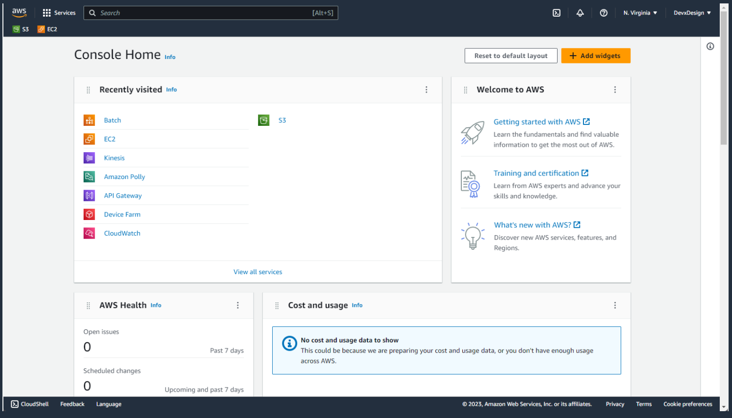
AWS Management Console
1
Create an AWS account
2
Login to the AWS Management Console
3
Deploy and create your applications

Slide 28
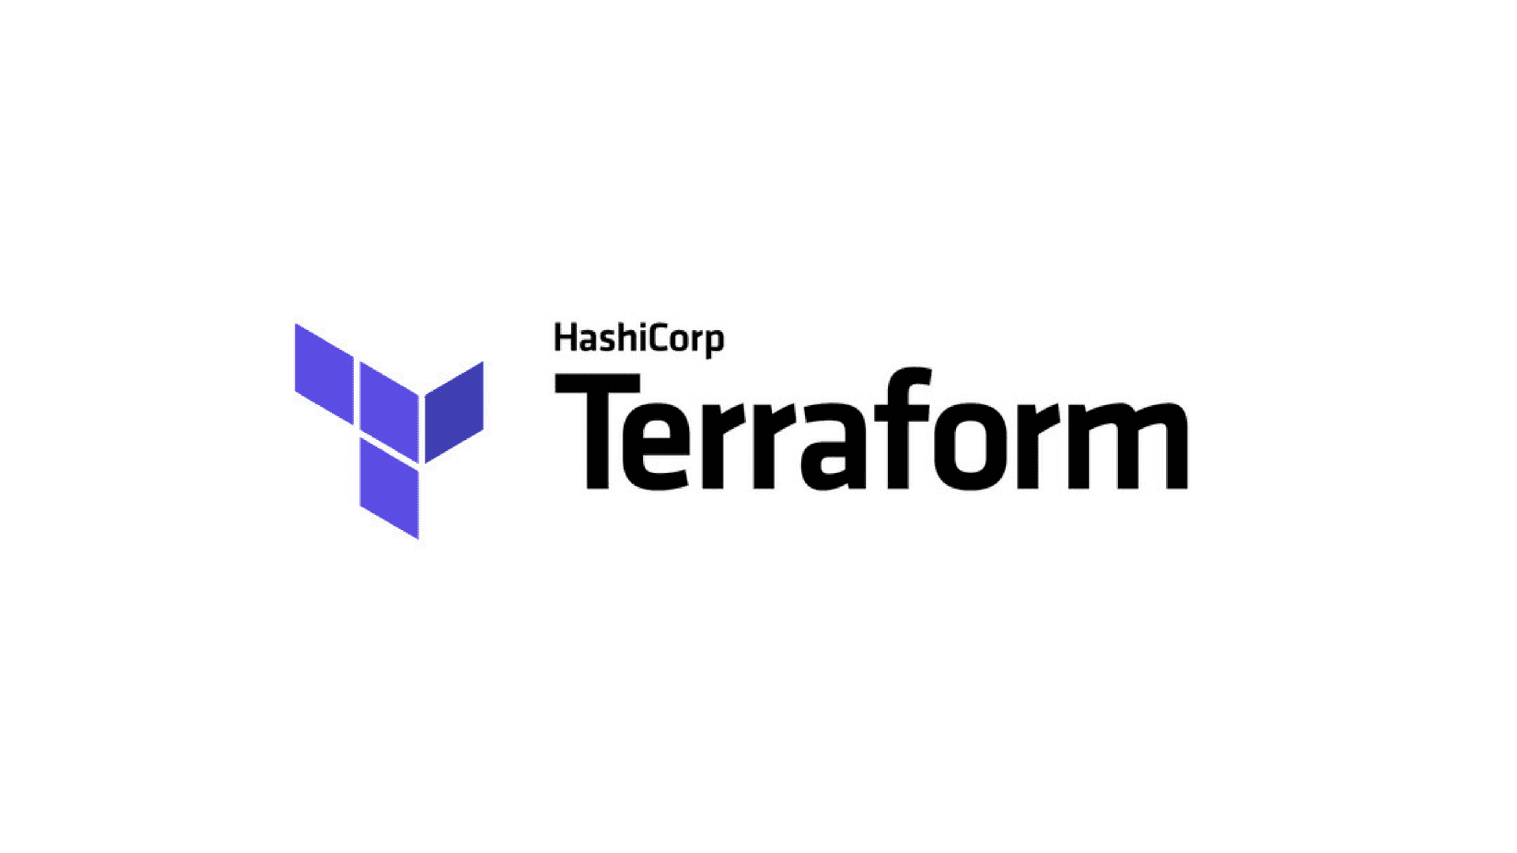

Overview of Deployment Options on AWS
AWS offers multiple options for provisioning infrastructure and deploying your applications (link). Even-though you can deploy your resources through the AWS Management Console, you should do it through Infrastructure as Code (IaC).
Infrastructure as Code is a way of provisioning and managing cloud resources by writing a template file that is both human-readable and machine consumable. For AWS, the built-in choice for IaC is AWS CloudFormation. A lot of customers also deploy it through Terraform.
AWS CloudFormation
Terraform by HashiCorp

Slide 29
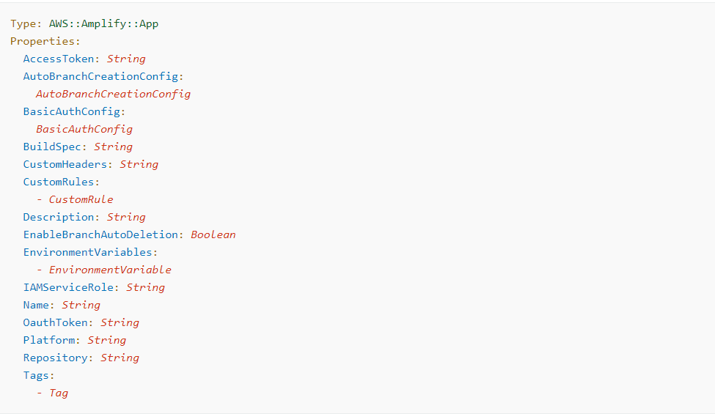
Overview of Deployment Options on AWS
AWS CloudFormation
Cloudformation-template.yaml

Slide 30
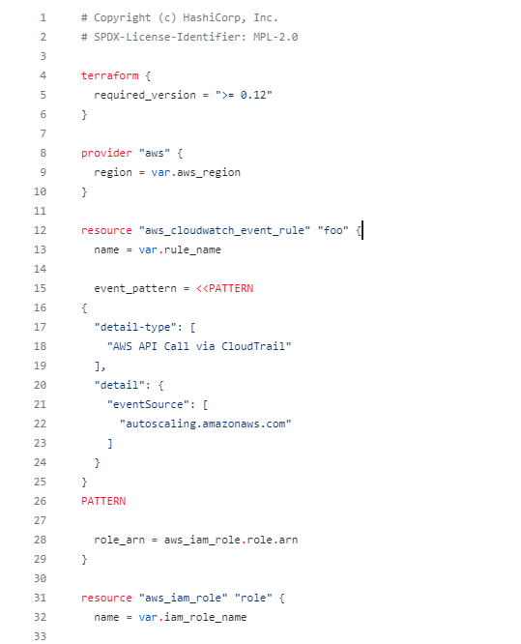
Overview of Deployment Options on AWS
Terraform-template.tf

Slide 31
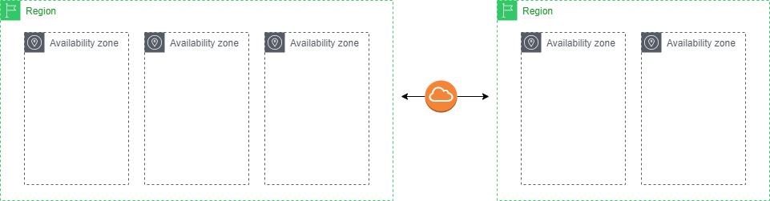
AWS Global Infrastructure
A Region is a physical location in the world and is independent from each other and they are geographically
distant from each other as well. The regions are connected via a high bandwidth, fully redundant network.
An Availability Zone (AZ) is composed of one or more data centers. Each region consists of two or more AZs.
Global Infrastructure Regions & AZs (amazon.com)

Slide 32
AWS Global Infrastructure
32 Launched Regions
Each with multiple Availability Zones (AZs)
102 Availability Zones

Slide 33
Amazon Resource Names (ARN)
Amazon Resource Names (ARNs) uniquely identify AWS resources. We require an ARN when you need to specify a resource unambiguously across all of AWS. (Link) Therefore, any resource you provision in your AWS account will have its own ARN.
arn:partition:service:region:account-id:resource-id
arn:partition:service:region:account-id:resource-type/resource-id
arn:partition:service:region:account-id:resource-type:resource-id

Slide 34
AWS Payment models
Pay-as-you-go
Pay-as-you-go pricing allows you to easily adapt to changing business needs without overcommitting budgets and improves your responsiveness to changes.
Save when you commit
Save when you commit is a flexible pricing model that provides significant savings on your AWS usage. You can sign up for Saving Plans for a 1- to 3-year term and easily manage your plans by taking advantage of AWS Cost Explorer.
Pay less by using more
You can get volume-based discounts and realize important savings as your usage increases. To optimize your savings, choose the right combinations of storage solutions that help you reduce costs while preserving performance and security.

Slide 35
AWS Free tier
AWS offers a free usage tier for up to 1 year.
Free trials
12 months free
Always free
Short-term free trials for a limited time
Expires 1 year after your initial sign-up date to AWS
Always free usage available to all AWS customers
Free Cloud Computing Services - AWS Free Tier (amazon.com)

Slide 36
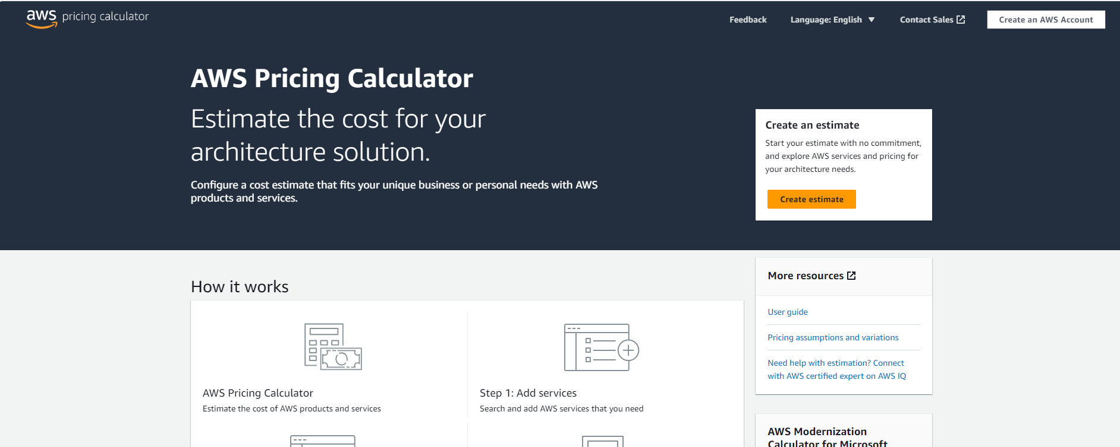
AWS Pricing Calculator
AWS Pricing Calculator

Slide 37
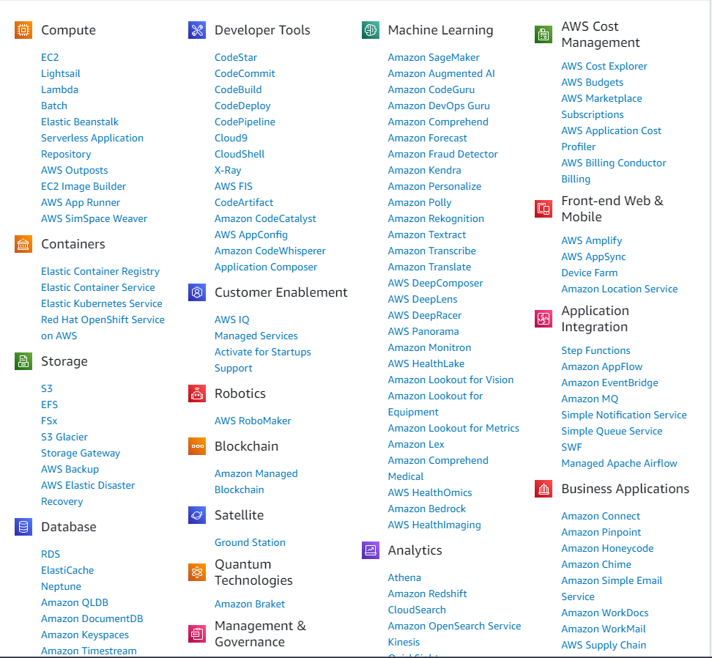
AWS Services
Snapshot of AWS Services taken at 10/9/2023

Slide 38
How do I start?
Security is Job 0
Snapshot of AWS Services taken at 10/9/2023

Slide 39
AWS Security Fundamentals

Slide 40
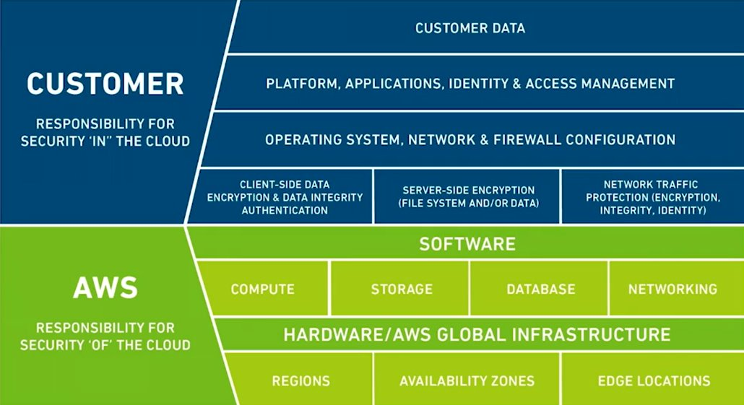
Who is responsible for security?

Slide 41




Learn the fundamental patterns
Permissions management:
AWS Identity and Access Management
(AWS IAM)
Data encryption:
AWS Key Management Service
(AWS KMS)
Network Security Controls:
Amazon Virtual Private Cloud
(Amazon VPC)

Slide 42
Secure an AWS environment
Control your cloud infrastructure
AWS Identity and Access Management (AWS IAM)
Control your data
AWS Key Management Service (AWS KMS)
Control your network
Amazon Virtual Private Cloud (Amazon VPC)

Slide 43
AWS Security Fundamentals
AWS Identity and Access Management (IAM)

Slide 44
Secure an AWS environment
Control your cloud infrastructure
AWS Identity and Access Management (AWS IAM)
Control your data
AWS Key Management Service (AWS KMS)
Control your network
Amazon Virtual Private Cloud (Amazon VPC)

Slide 45
AWS IAM
AWS IAM is the way to handle Authentication and Authorization in AWS.
The “I” stands for Authentication: Support for human and application caller identities.
The “AM” stands for Authorization: Powerful, flexible permissions language for controlling access to cloud resources.
Every AWS service uses IAM to authenticate and authorize API calls

Slide 46
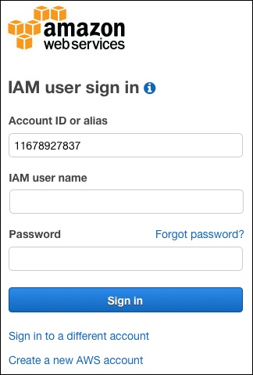
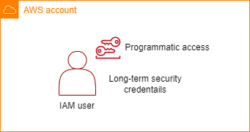
AWS identities for human callers: IAM users
IAM user for ROOT access
IAM user with programmatic access

Slide 47
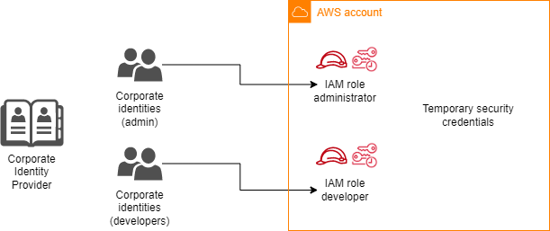
AWS identities for human callers: Federated Identities

Slide 48




AWS identities for non-human callers
IAM roles for AWS services
Amazon EC2
instance
AWS Lambda
function
Amazon SageMaker
notebook
…and many others

Slide 49
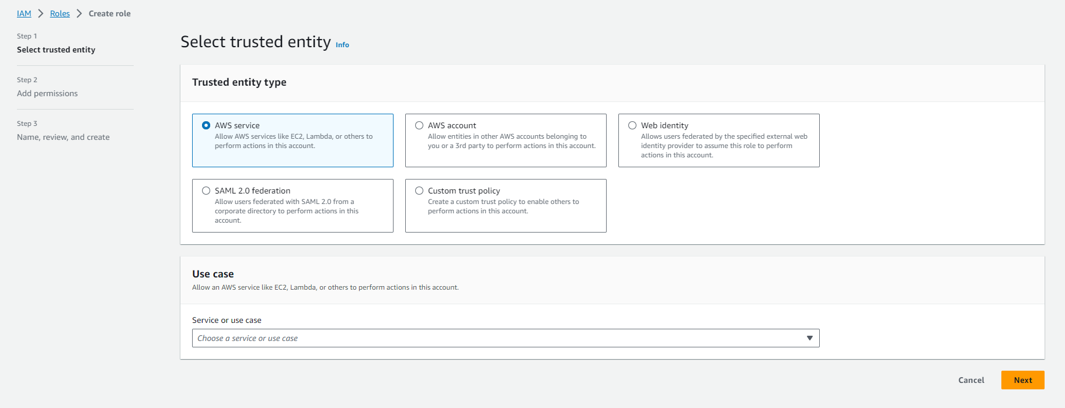
Creating a role in AWS Management Console
Role for Non-human identities

Slide 50
Creating a role in AWS Management Console
Role for cross-account access

Slide 51
Creating a role in AWS Management Console
Role for federated (human) identities
Role for federated (human) identities

Slide 52
Creating a role in AWS Management Console
Custom trust policy

Slide 53

How an authentication works in AWS
API request signed with
secret key
AWS Management Console
Via
IAM role
AWS Command Line Interface (CLI)
Amazon Simple Storage Service
(Amazon S3)
AWS Tools and SDK’s

Slide 54
IAM Policies
To perform any type of task in AWS, you need to have an IAM policy that gives you the permission to do so. There are two types of IAM polies:
AWS-managed policies: AWS have a set of pre-defined IAM policies for common tasks. Really useful for IAM human-identities that have typical set of actions that they would like to do.
Custom policies: IAM policies created by you where you specify the exact permissions that this policy should provide. You always apply the least privilege principle.

Slide 55
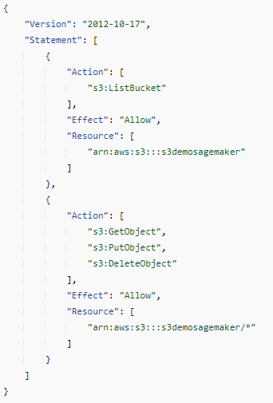
IAM Policies
An IAM policy is a list of statements. Every statement have different parts:
Action: The action explains you what you can (or can’t) do.
Effect: Each action is linked to an effect: either Allow or Deny.
Resource: It also specify to what you can (or can’t) do it.
The custom policy should be as specific as possible, following the least
privilege design principle. However, you could also use the “*” to indicate
“everything/all”.
You could also have Conditions, where you can implement an attribute-based
access control (ABAC) based on tags.

Slide 56



What happens when I have multiple AWS accounts?
When working with enterprise customers, most of their AWS enterprise environment will consist of multiple AWS accounts. And, therefore, they will need to secure the environment across the different AWS accounts.
AWS Cloud
AWS account A
AWS account B
AWS account C

Slide 57


IAM cross-account access
Common scenario: Some IAM principal from one AWS account needs to get access to a resource in another AWS account. To accomplish that, you need an Allow from both accounts.
{ “Effect” : “Allow”,
“Principal”: {“AWS”: “arn-aws-root-account”},
“Action”: “s3:GetObject”,
“Resource”: “arn:aws:my-bucket/*” }
{ “Effect” : “Allow”,
“Action”: “s3:GetObject”,
“Resource”: “arn:aws:s3:other-account-bucket” }
AWS account A
AWS account B
IAM Policy
Amazon S3 bucket policy
Caller IAM role
Amazon S3 bucket

Slide 58

IAM cross-account access
Some of the AWS services do not support resource-based policies. In such cases, you need to define a cross-account IAM role.
{ “ Effect” : “Allow”,
“Action” : “sts:AssumeRole”,
“Resource”: “ARN for cross-account IAM role}
{ “ Effect” : “Allow”,
“Action” : “dynamodb:GetItem”,
“Resource”: “DynamoDB table ARN”}
AWS account A
AWS account B
Caller IAM role
Cross-account access IAM role
DynamoDB table
{ “ Effect” : “Allow”,
“Action” : “sts:AssumeRole”,
“Principal”: { “AWS” : accountA root”} }

Slide 59
IAM cross-account access
Some of the AWS services do not support resource-based policies. In such cases, you need to define a cross-account IAM role.
{ “ Effect” : “Allow”,
“Action” : “sts:AssumeRole”,
“Resource”: “ARN for cross-account IAM role}
{ “ Effect” : “Allow”,
“Action” : “dynamodb:GetItem”,
“Resource”: “DynamoDB table ARN”}
AWS account A
AWS account B
Caller IAM role
Cross-account access IAM role
DynamoDB table
{ “ Effect” : “Allow”,
“Action” : “sts:AssumeRole”,
“Principal”: { “AWS” : accountA root”} }

Slide 60
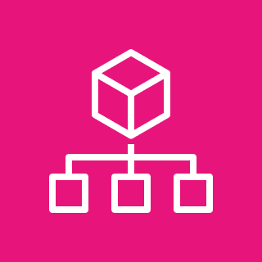

Managing multi-account environments
AWS Organizations
AWS Cloud
AWS Organizations
Organizational unit (OU)
Organizational unit (OU)
AWS account A
AWS account B
AWS account C
AWS account D

Slide 61
Managing multi-account environments
AWS Organizations
You can use AWS Organizations service control policies to bound access throughout AWS Organizations, to an OU or to a specific account.
AWS Cloud
Service Control Policy
AWS Organizations
Organizational unit (OU)
Organizational unit (OU)
AWS account A
AWS account B
AWS account C
AWS account D

Slide 62
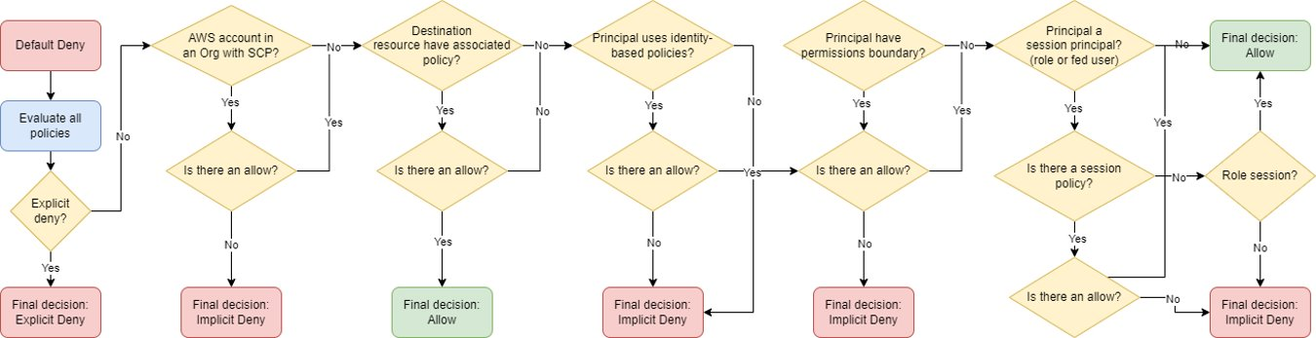
Policy Evaluation Logic

Slide 63
AWS Security Fundamentals
AWS Key Management System (KMS)

Slide 64
Secure an AWS environment
Control your cloud infrastructure
AWS Identity and Access Management (AWS IAM)
Control your data
AWS Key Management Service (AWS KMS)
Control your network
Amazon Virtual Private Cloud (Amazon VPC)

Slide 65
AWS KMS
AWS KMS is the AWS-managed encryption and decryption service. Many of the data-handling AWS services offer simple AWS KMS integrations.
If you know how to use AWS KMS, you can protect your data at rest simply and with no management overhead.
More than 50+ AWS Services have AWS KMS already integrated with the service itself. Meaning that it is just a configuration that needs to be activated.

Slide 66
AWS KMS
Data <=4KB
Application data
KMS.Encrypt(“Hello world”) -> sfdaweFS…
KMS.Decrypt(“sfdaweFS…”) -> Hello world
Envelope encryption

Slide 67



Envelope Encryption
Data Key
Data
Encrypted data

Slide 68

Envelope Encryption
Data Key
Data Key
Data
Encrypted data

Slide 69
Envelope Encryption
Data Key
Data
Encrypted data
Data Key
Master Key

Slide 70
Envelope Encryption
Data Key
Data
Encrypted data
Encrypted
data key
Data Key
Master Key
Stored together

Slide 71
Envelope Encryption
Data Key
Data
Encrypted data
Encrypted
data key
Data Key
Master Key
Stored together
Master Key

Slide 72
Envelope Encryption
Data Key
Data
Encrypted data
Encrypted
data key
Data Key
Master Key
Stored together
Master Key

Slide 73
Envelope Encryption
Data Key
Data
Encrypted data
Encrypted
data key
Data Key
Master Key
Stored together
Master Key

Slide 74
AWS KMS
Application data
KMS.GenerateDataKey
Data Key
Encrypted
data key
Use Data Key to encrypt your data, then discard
Encrypted data
Store encrypted data key alongside with your data
Encrypted data
Encrypted
data key
Stored together

Slide 75
AWS KMS
Application data
KMS.Decrypt(encryptedDataKey)
Data Key
Encrypted
data key
Then decrypt the data with the Data key.
Data

Slide 76
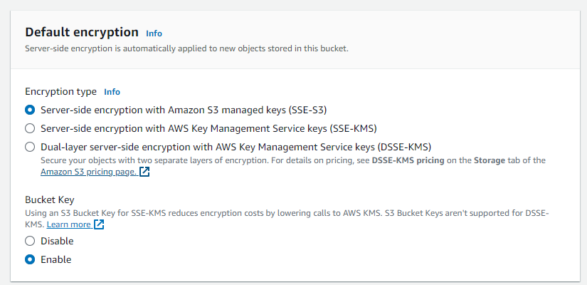
AWS KMS
Amazon S3 Bucket
Amazon S3 manages the encryption key
An AWS KMS key in your account is used for
Encryption.

Slide 77

IAM Permissions for AWS KMS Keys
{ “ Effect” : “Allow”,
“Action” : “s3:GetObject”,
“Resource”: “mybucket/*
}.
IAM Policy
S3.GetObject
Amazon S3 encrypted
with KMS

Slide 78

IAM Permissions for AWS KMS Keys
{ “ Effect” : “Allow”,
“Action” : “s3:GetObject”,
“Resource”: “mybucket/*
}.,
{
“Effect” : “Allow”,
“Action”: “kms:Decrypt”,
“Resource”: “kmsKey” }
IAM Policy
S3.GetObject
Amazon S3
Amazon S3 encrypted
with KMS

Slide 79
AWS Security Fundamentals
AWS Virtual Private Cloud (VPC)

Slide 80
Secure an AWS environment
Control your cloud infrastructure
AWS Identity and Access Management (AWS IAM)
Control your data
AWS Key Management Service (AWS KMS)
Control your network
Amazon Virtual Private Cloud (Amazon VPC)

Slide 81
What is an Amazon VPC?
When you deploy cloud infrastructure, your VPC is the network that provides connectivity to
and from that infrastructure.

Slide 82

Amazon VPC 101
AWS Cloud
AWS Region (e.g., us-east-1)
Availability Zone (e.g., us-east-1a)
Availability Zone (e.g., us-east-1b)
Availability Zone (e.g., us-east-1a)

Slide 83

Amazon VPC 101
AWS Cloud
AWS Region (e.g., us-east-1)
Availability Zone (e.g., us-east-1a)
Availability Zone (e.g., us-east-1b)
Availability Zone (e.g., us-east-1a)
Virtual private cloud (VPC) (e.g., 10.0.0.0/16)

Slide 84


Amazon VPC 101
AWS Cloud
AWS Region (e.g., us-east-1)
Availability Zone (e.g., us-east-1a)
Availability Zone (e.g., us-east-1b)
Availability Zone (e.g., us-east-1a)
Virtual private cloud (VPC) (e.g., 10.0.0.0/16)
Public subnet (10.0.0.0/24)
Public subnet (10.0.1.0/24)
Public subnet (10.0.2.0/24)
Private subnet (10.0.50.0/24)
Private subnet (10.0.51.0/24)
Private subnet (10.0.52.0/24)

Slide 85



Amazon VPC 101
AWS Cloud
AWS Region (e.g., us-east-1)
Availability Zone (e.g., us-east-1a)
Availability Zone (e.g., us-east-1b)
Availability Zone (e.g., us-east-1a)
Virtual private cloud (VPC) (e.g., 10.0.0.0/16)
Public subnet (10.0.0.0/24)
Public subnet (10.0.1.0/24)
Public subnet (10.0.2.0/24)
Private subnet (10.0.50.0/24)
Private subnet (10.0.51.0/24)
Private subnet (10.0.52.0/24)

Slide 86
Security Groups
AWS Cloud
AWS Region (e.g., us-east-1)
Availability Zone (e.g., us-east-1a)
Availability Zone (e.g., us-east-1b)
Availability Zone (e.g., us-east-1a)
Virtual private cloud (VPC) (e.g., 10.0.0.0/16)
Security group
NLB
NLB
NLB
Instances
Instances
Instances
Security group
Security group
Amazon RDS
Amazon RDS

Slide 87
Part 2: Hands-on

Slide 88
AWS Educate
Learn and practice cloud skills
The hands-on labs will be done through AWS Educate platform. AWS Educate is open to any individual, regardless of where they are in their education, technical experience, or career journey.
1
Create an account in AWS Educate platform
AWS Educate - Cloud Services for Education- AWS (amazon.com)
2
Sign-in to AWS Educate platform

Slide 89
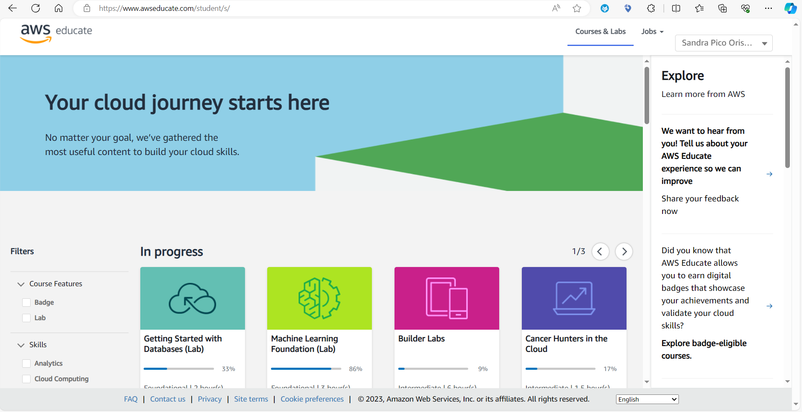
AWS Educate

Slide 90
AWS Educate
Objectives from Hands-on Labs
Hands-on labs are meant for students to have the opportunity to test AWS platform without incurring any cost.
There will be no evaluation on the Hands-on labs content as part of the course. However, they are useful to consolidate the theory explained and improve your knowledge on the topics presented.
At the end of each session, you will have some time to start the Hands-on Labs. However, if you do not have time to finish them, you can continue them at home.
During the lab time, you can ask me questions or any doubt you might have on the topics.
The labs will help you consolidate the knowledge and prepare you better for your final project.
The labs also include theory. The theory can be reviewed, or you can directly go to the Lab itself.

Slide 91
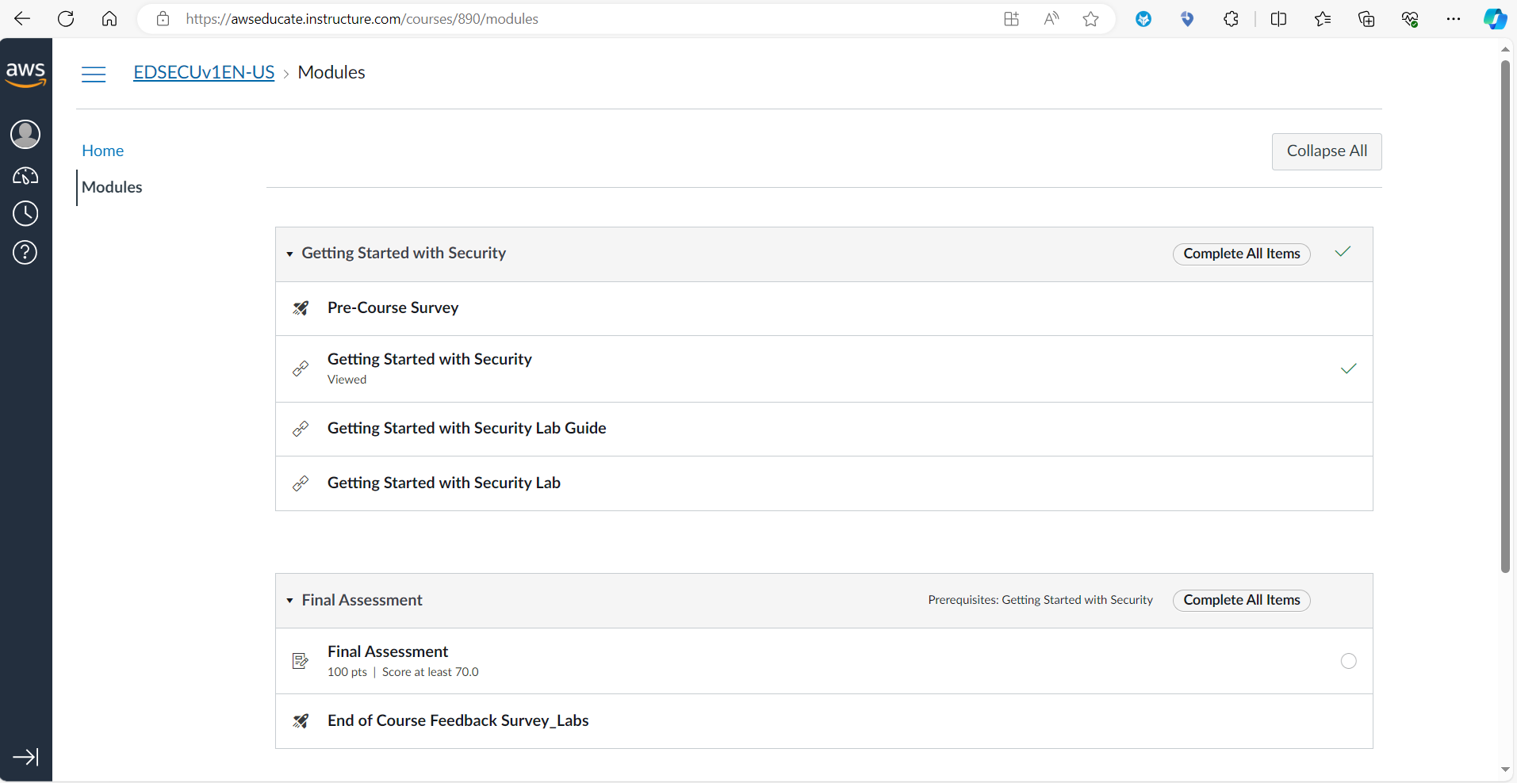
AWS Educate
Theory
Lab

Slide 92
Introduction to the Hands-on Labs

Slide 93
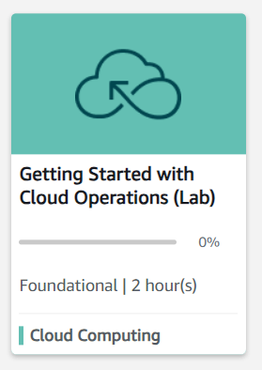
Hands-on Labs
AWS Educate Labs
1
Getting Started with Cloud Operations
Link
Getting Started with Cloud Operations (instructure.com)
Lab duration
~30 minutes
Description
This hands-on lab guides you through the steps to estimate Amazon Web Services (AWS) costs for a sample workload.
To estimate the AWS costs, it leverages AWS Pricing Calculator.

Slide 94
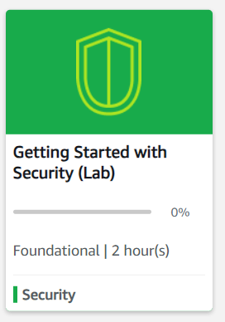
Hands-on Labs
AWS Educate Labs
2
Getting Started with Security
Link
Getting Started with Security (instructure.com)
Lab duration
~40 minutes
Description
In this hands-on lab, you get a basic overview of AWS Identity and Access Management (IAM).With IAM, you can specify who or what can access services and resources in AWS, centrally manage detailed permissions, and analyze access to refine permissions across AWS. You use policies, users, groups, and roles to grant or restrict access based on the
needs of your organization.

Slide 95
Thank you

